Slide 1

Mental Health Outcomes and Early-Life Risk Factors
Yiling Yang 1306339

Slide 2
Research Topic & Objective
contents
Data Source
Statistical Methods
Results
Conclusion

Slide 3
01
Research Topic & Objective

Slide 4

  Topic & Objective
Topic
Mental health issues are an important global public health problem.
1
To emphasize the public health importance of mental health outcomes.
Objective
2
To support data-driven understanding of mental health risks.
3
To analyze depressive symptoms using large-scale, nationally representative health survey data.

Slide 5
02
Data Source

Slide 6
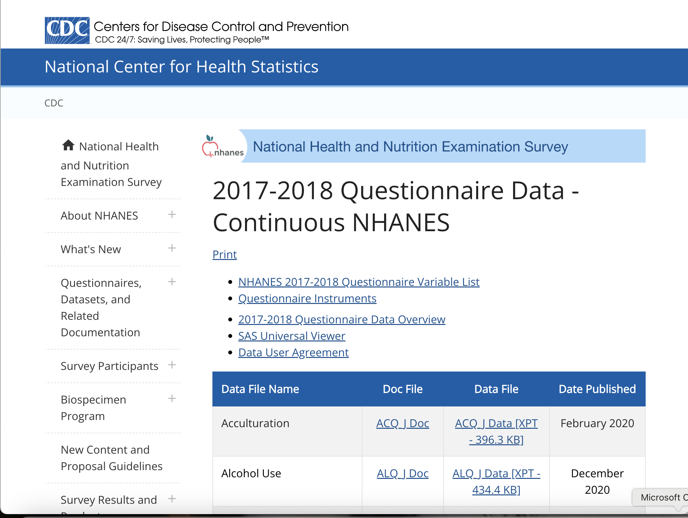
Data Source
NHANES (National Health and Nutrition Examination Survey)
Data Source
Centers for Disease Control and Prevention (CDC)
Conducted By
1. Nationally representative
2. Publicly available & anonymized data
Key Features
Official Website
https://www.cdc.gov/nchs/nhanes/

Slide 7
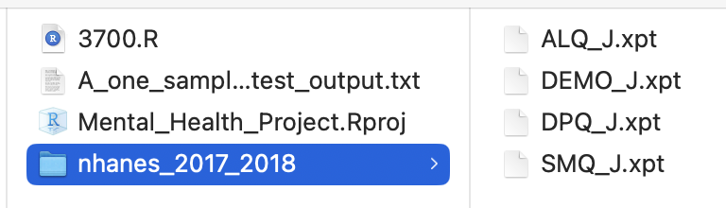
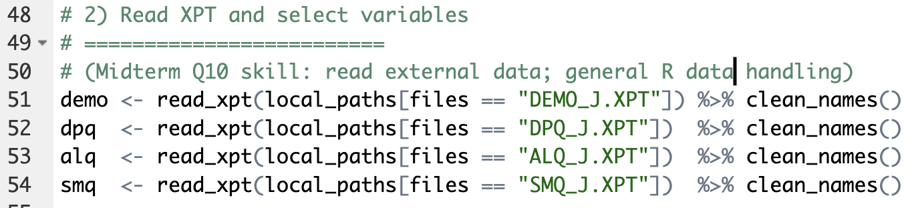
  Acquisition & Formats
Data Files Used
DEMO_J : Demographic information
DPQ_J:the PHQ-9 depression scale questionnaire response
ALQ_J : the alcohol consumption behavior questionnaire response
SMQ_J : the smoking behavior questionnaire response
All from the NHANES survey interview.
Data Format and Reading
NHANES data is published in XPT format .
Be imported using the read_xpt() function in R.

Slide 8
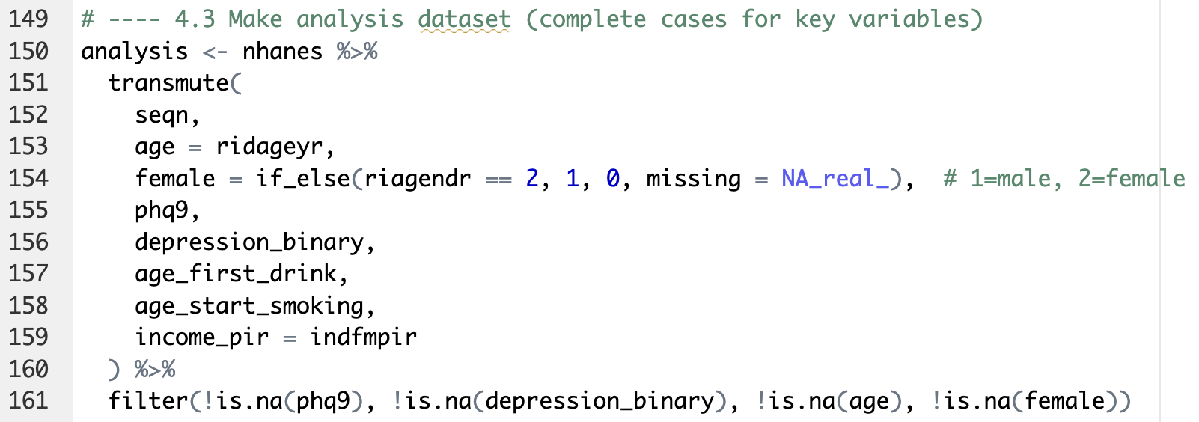
  Data Preparation
Data Cleaning & Preparation
This step creates the final analysis-ready datase.
Using transmute(), keep only the variables required for statistical testing.
Then, filter() removes observations with missing values in key analysis variables.

Slide 9
03
Statistical Method

Slide 10
  Statistical Method
Statistical Method Lists
01
Shapiro normality test
02
One-sample t-test
03
Two-sample t-test
04
One-way ANOVA + TukeyHSD + boxplot
05
Correlation + CI (Fisher z)
06
Simple linear regression + ANOVA table + prediction interva

Slide 11
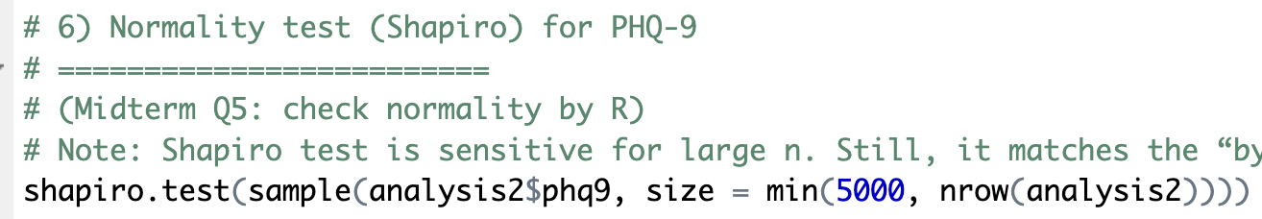
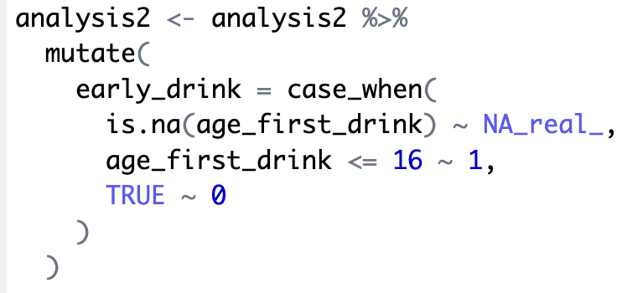
  Statistical Method
1
Normality test
Use the Shapiro–Wilk normality test to check whether the variable PHQ-9 is approximately normally distributed.
2
2
One-sample t-test
H₀: Mean PHQ-9 score = 0
H₁: Mean PHQ-9 score ≠ 0
3
Two-sample t-test
Create a binary grouping variable early_drink for later comparison of the PHQ-9 average values ​​of different groups.

Slide 12
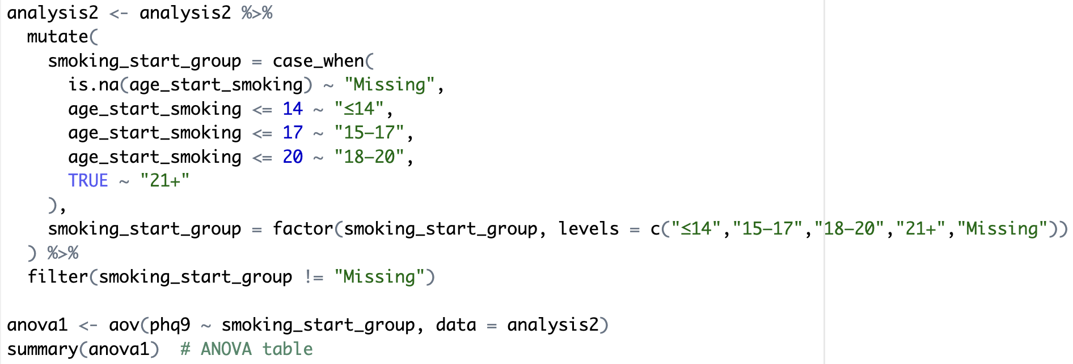
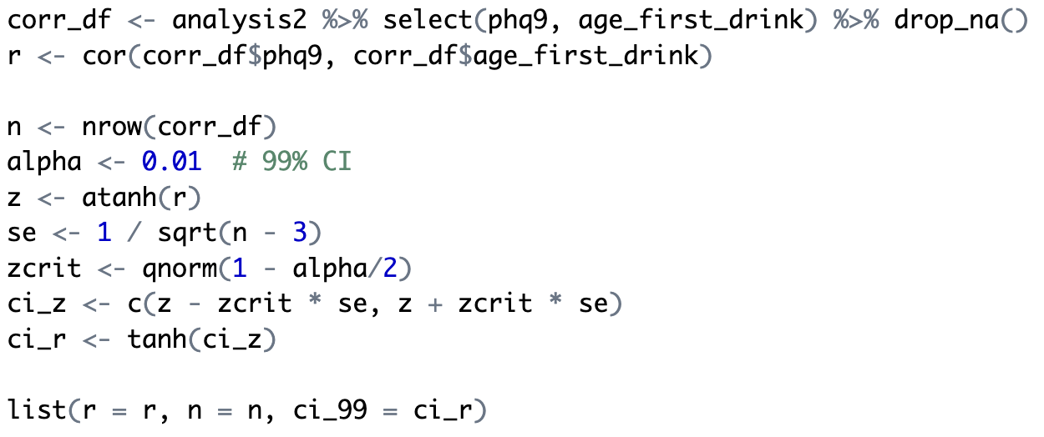
  Statistical Method
4
One-way ANOVA
5
Correlation + CI (Fisher z)

Slide 13
04
Results And Conclusion

Slide 14
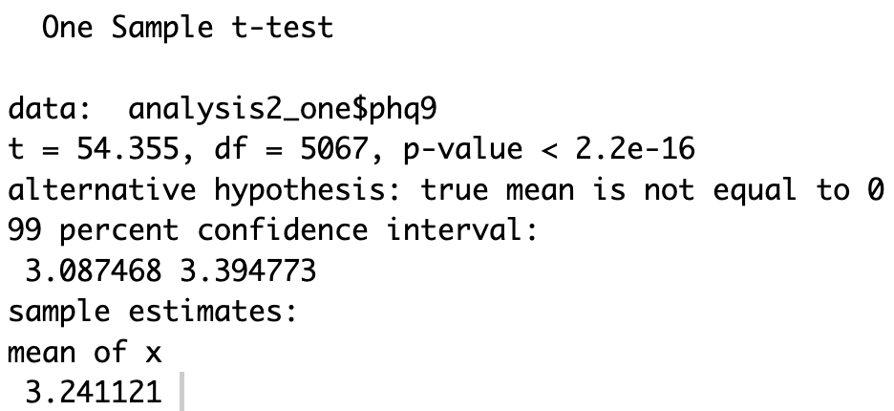
  Conclusion
Output：
Conclusion：
Using cleaned NHANES survey data, this project found that the average PHQ-9 score in the sample was 3.24, which is significantly different from zero based on a one-sample t-test (t(5067) = 54.36, p < 0.001, 99% CI [3.09, 3.39]). This indicates that depressive symptoms are present at a non-zero level in the surveyed population. Additional group-based analyses (t-test / ANOVA) and visualizations suggest that PHQ-9 scores vary across behavioral exposure groups, providing further descriptive insight into differences in depressive symptom levels.

Slide 15

Thank You For Listening
Yiling Yang 1306339

